Slide 1
Is It Abuse?
And I will deal severely with all who have oppressed you.
I will save the weak and helpless ones…
Zephaniah 3:19
Darby Strickland, CCEF

Slide 2
Marriage, a picture of Christ and his Church
Jesus relates to us
He is faithful
sacrificing
accepting
honoring
serving
honest
caring
Marriage is ultimately about God and his glory (Eph. 5)
When God designed marriage, he already had Christ and the church in mind.
One of God’s great purposes in marriage was to picture the relationship between Christ and his redeemed people forever.

Slide 3
We were Created to Worship God and Love Others
To Worship God
We were created to worship our creator
When he is the object of our desires and delight-we enjoy him and are like him
Any time our desires point away from God we will be left empty wanting more- we easily & routinely manufacture cheap & worthless idols- left unchecked our idolatry grows
The way you love reveals what you think about God
God’s triune nature he is relational- we were created to be relational
God commands us to love others- to do this well we have to uproot our idols, humble ourselves, trust God, often times giving up our own desires.
When we fail to love others well it exposes our idols

Slide 4
Descent of a Desire
I desire
I want
I need
I demand I Will Wound & Punish

Slide 5
Prevalence- Abuse rates are the same in the church
25% of marriages are abusive¹
1 in 4 women report being in an abusive relationship.²
24% of women & 13 % of men report experiencing severe physical violence from an intimate partner. ²
50 % of men who assault their wives frequently assault their children.²
In households where abuse occurs 50% of children are also being directly abused by the same person
Forced Sex or Sexual Assault occurs in 40-45% of battering relationships.⁴

Slide 6
Definition of Oppression
Oppression is the opposite of God’s design for marriage.
Abuse occurs in a marriage
when one spouse pursues their own self-interests by seeking to control
and dominate the other through a pattern of coercive, controlling, and punishing behaviors.
Physical
Sexual
Emotional
Financial
Spiritual
Extreme Neglect
Deception

Slide 7


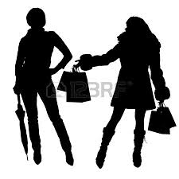
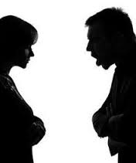
All Marriages are Comprised of 2 Sinners
Two idolatrous sinners How well we live out Jesus' two great commandments. Matt. 12: 30-31 Shows us the state of our depravity, our heart and reveals our idols
Two idolatrous sinners plus one sin pattern that creates additional suffering for the couple.
Two idolatrous sinners but one’s sin pattern leads them to seek to control and dominate the other.

Slide 8
We are looking for a pattern
Relate to Others
Self Deceptions
Entitled
Dominate
Threaten
Oppressive people enslave others- Enslavement
is the anti-love
Blind
Lack Remorse
Blame-shift
Oppressive people are self justifying
Self-righteousness
“I have no need of Jesus”

Slide 9
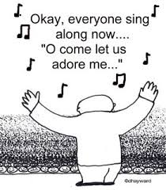
Oppressive People Insist That
1. It is only their rules
that need to be followed.
2. It is only their words
that need to be heard & obeyed.
3. It is only their emotions
that are under consideration in relationships.
4.It is only their physical and sexual needs
that need to be considered and fulfilled.
They demand to be worshiped

Slide 10
Enforced Worship
I have a right to the things I want,
and I will punish whoever stands in the way of my desires.
“Serve me or suffer the consequences.”
In oppressive marriages,
punishment is the ruling force.
Punishments are perpetually utilized
to keep control.

Slide 11

We all have punishing behaviors.
Yes even me and you.

Slide 12
When does the punishment or punishments become so severe to call it abuse?

Slide 13
Spectrum of Abuse
Weakness
Exploitation
Lacks Empathy
Cruel and Dangerous
ASD
Historical
Immaturity
Manipulative
Entitled

Slide 14
Was this a punishment? if so for what?
Is there recognition it is wrong with true repentance?
How often does this occur?
Is it Abuse?
Establish Coercive Control
Who repairs the relationship and why?
For how long?
ignoring wife
Can she express how this is hurting her without punishment?
Does it accomplish something?
How does it change the wife's future behavior?
What is the affect on the wife?

Slide 15
Resistive Violence including both legal and illegal use of force which is used by victims of battering to control their abuser’s use of coercive and controlling tactics or in reaction to other men’s violence against them as women.
Pathological Violence, in which ending or controlling the pathology would end the violence (mental illness, drug and alcohol addiction with no pattern of coercion and entrapment of the partner, brain damage);
Common Couple’s Violence, in which one or both parties use violence, but it is not part of an ongoing pattern of coercion and intimidation; no element of entrapment is present.

Slide 16
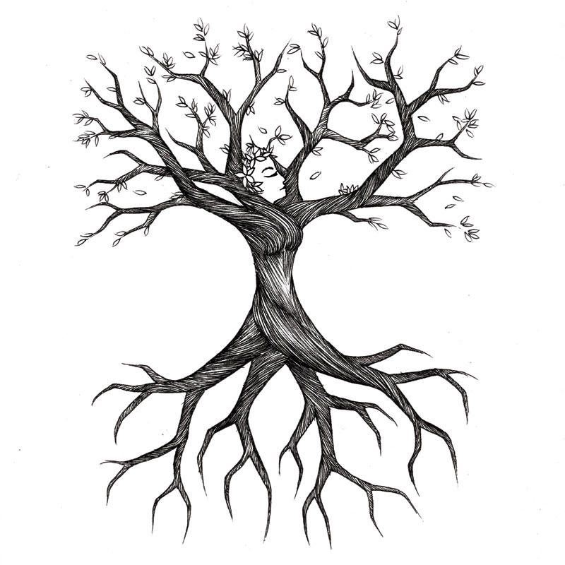
Abuse grows from attitudes and values, not feelings.
Branches are control
Trunk is entitlement
Roots are
self-worship
"What comes out of a person is. . . from within (them), out of a person's heart, that evil thoughts come—sexual immorality, theft, murder, adultery, greed, malice, deceit, lewdness, envy, slander, arrogance and folly. All these evils come from inside (them).” - Mark 7:20-23

Slide 17
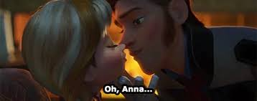
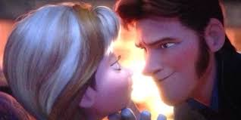
Not about anger management.
When a man is selective about
when
where and
to whom he is abusive
The problem is not he loses control… it is that he takes control.
Usually, when we are not looking…
Public Face of Oppressor
Private Face of Oppressor

Slide 18
It is not that oppressors are 'out of control' it is quite the opposite- they are using violence to maintain control.
Herod
Haman
Matt 2: 16-18
Then Herod, when he saw that he had been tricked by the wise men, became furious, and he sent and killed all the male children in Bethlehem and in all that region who were two years old or under, according to the time that he had ascertained from the wise men. ¹⁷ Then was fulfilled what was spoken by the prophet Jeremiah:¹⁸
“A voice was heard in Ramah,
weeping and loud lamentation,
Rachel weeping for her children;
she refused to be comforted, because they are no more.”
Esther 3: 5-6
And when Haman saw that Mordecai did not bow down or pay homage to him, Haman was filled with fury. ⁶ But he disdained to lay hands on Mordecai alone. So, as they had made known to him the people of Mordecai, Haman sought to destroy all the Jews, the people of Mordecai, throughout the whole kingdom of Ahasuerus.
We need to look and see what is motivating them

Slide 19
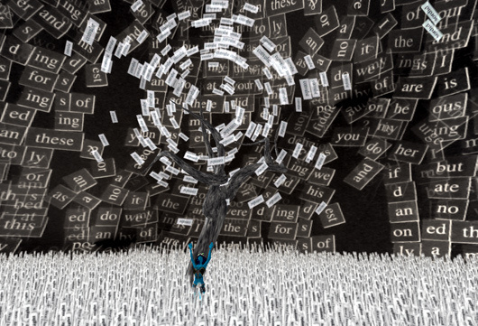
The Oppressed Experience
Being owned
Confused
Enslavement
Crushed
Alone
Physically Ill
Feels Responsible
Devalued
Angry
Guilty

Slide 20
Physical Violence
The Lord hates violence
Let him rain coals on the wicked;
fire and sulfur and a scorching wind
shall be the portion of their cup. Ps 11:5
A. Unpredictable
B. Escalates
C. Terrifying to
1. experience
2. reveal
    We must see
    We must respond
    Seek to be God glorifying
The prudent sees danger and hides himself,
but the simple go on and suffer for it.
Pv. 22:3

Slide 21
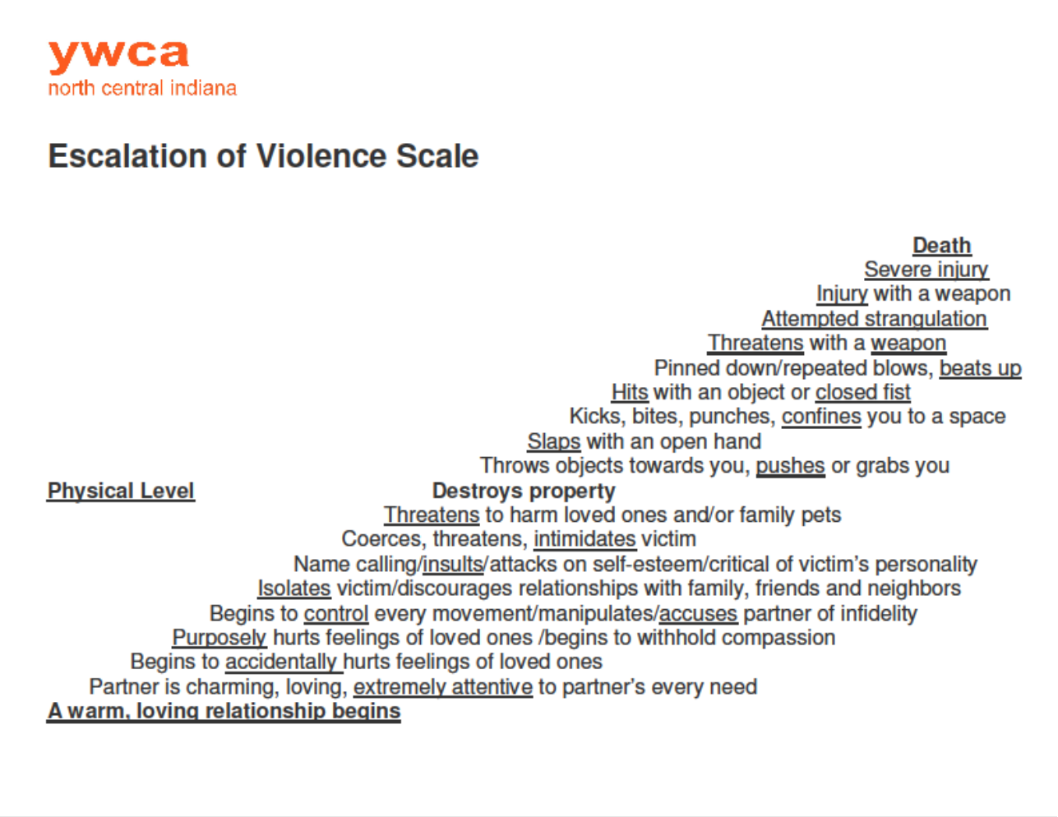

Slide 22
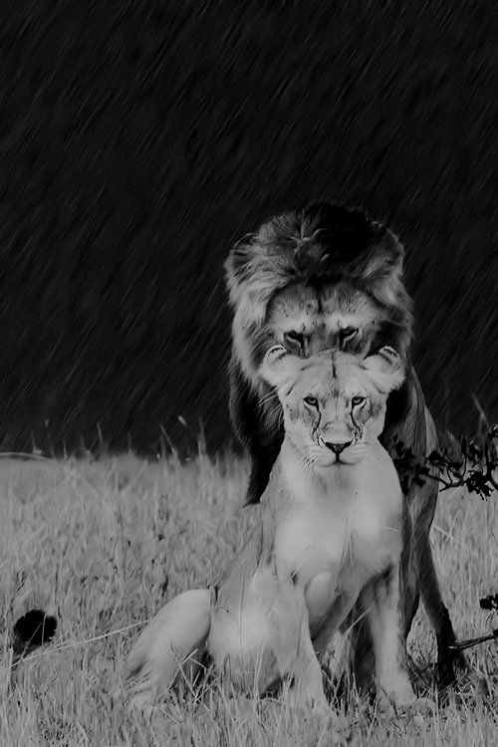
Emotional Abuse (mental, verbal or psychological)
A pattern of behavior which promotes a
destructive sense of
fear,
obligation,
shame or
guilt.

Slide 23
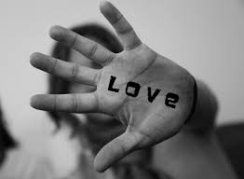
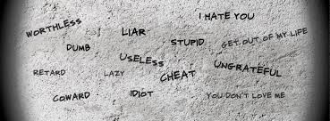
What it Looks Like
Rejecting
Neglecting
Degrading
Terrorizing
Isolating
Exploiting
Belittling
Gas lighting
Deceiving
Blaming
Ignoring
Shaming
Threatening
If an enemy were insulting me,
I could endure it;
if a foe were rising against me,
I could hide.
But it is you, a man like myself,
my companion, my close friend,
with whom I once enjoyed sweet fellowship
at the house of God Ps. 55

Slide 24
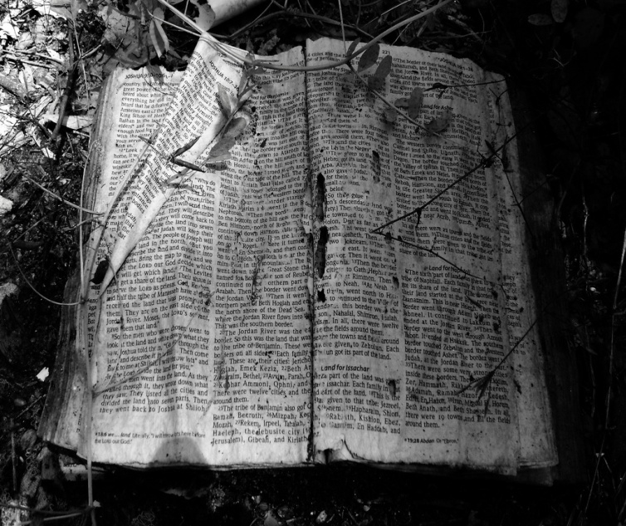
Spiritual Abuse
When control and domination are established by using Scripture, doctrine, or one's 'leadership role' as weapons.
Exhibiting control- oriented leadership
Lording power over you
Demanding submission
Using scripture to shame or punish
Hyper-Headship
Can be experienced as if the abuse were from God himself.
It becomes hard to distinguish what God says from the voice the oppressor.
For there are many who are insubordinate, empty talkers and deceivers. . . They must be silenced, since they are upsetting whole families by teaching for shameful gain what they ought not to teach. Titus 1:10-11

Slide 25
Sexual Abuse
Entitlement in the Bedroom
When what God designed to be an expression of union and peace
is corrupted
by power and control unspeakable things happen.
The Pressing Spouse
The Insatiable Spouse
The Limit Pusher
The Intrusion of Pornography
The Coercive Spouse
The Violator

Slide 26
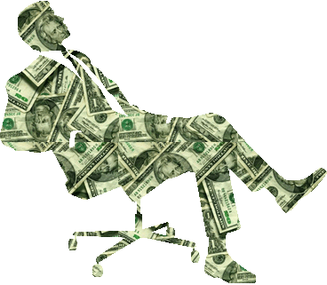
Financially abusive behavior
Closely watching what you buy.
Hiding assets- or Keeping you from seeing shared bank accounts or records.
Using your social security number to obtain credit without your permission.
Running up debt without unity or knowledge.
Refusing to give you money, food, rent, medicine or clothing.
Spending money on themselves but not allowing you to do the same.
Not including the victim in investment or banking decisions
Canceling Life or Insurance policies without consent or knowledge
Controlling how all $ is spent .
Refusing to work or contribute to the family income.
All assets are placed in their name.
Preventing you from going to work by taking your car or keys.
Sabotaging work or employment opportunities
Forcing the victim to commit
insurance fraud,
write bad checks.

Slide 27

Discovering Abuse
Do you have the freedom to be yourself, make decisions, give your input and disagree?
Do you ever feel fearful around your partner?
Have you ever been threatened or physically hurt?
Have you ever been an unwilling participant in a sexual act?

Slide 28
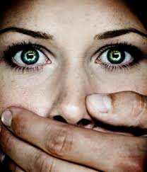
HOW WE MIGHT CONTRIBUTE TO MISSING IT.
Silence them:
Focus on your own sin.
Do not speak poorly of spouse or without him present?
Comparing our marriages to theirs.
Minimize their cries for help.
Blame them:
How did you provoke that?
Simplistic focus on submission.
Can see their sin more easily
Challenge them as they flee danger.
Notes:
Oppression only needs silence to – victims require

Slide 29
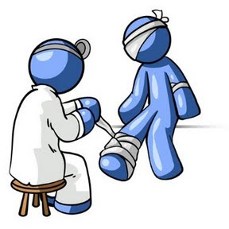
Where should the focus be?
External Sin- Safety & Suffering
Internal Sin- personal sin
Still called to a life of repentance and faith-
1. God is patient- so we can be too!
2. Wisdom when to bring this into focus- safety, seeing God, knowing their pain
3. Is there an immediate improvement to be made?

Slide 30
God sees you
Oppression is isolating, and it can feel like no one, not even God sees or cares about what is happening to you.
  "For you are the God in whom I take refuge; why have you rejected me? Why do I go about mourning because of the oppression of the enemy?” - Ps. 43:2
Take comfort in knowing he sees you and what is done to you. Jesus not only sees, he know what it is like because it happened to him,
  "He was despised and rejected by men; a man of sorrows, and acquainted with grief . . . He was oppressed, and he was afflicted.”- Isa. 53:3, 7

Slide 31

God cares about your safety.
Sin intensifies over time.
Continual & unrepentant sin causes hearts to grow hard.
Desensitized hearts not only perpetuate sin,
they magnify it.
God’s word is clear on the dangers of unrepentant habitual sin.
We should not be unwisely optimistic
Abigail and Nabal
Egyptian Midwives
Jesus Fleeing-
    Matt 12:3-4 Pharisee's colluding to kill him, he withdraws
    John 8:58-59 They picked up stones to stone him and he hides- slips out
    John 11:53-54 They plotted to take his life so he no longer moved publicly and withdrew to the wilderness.
Paul- repeatedly fled abusive situations
  Acts 9:22-25; 14:5-7;17:8-10,14
Vindicate me, O God, and defend my cause against an ungodly people,
From the deceitful and unjust man deliver me!
For you are the God in whom I take refuge… Ps 43:1-2

Slide 32
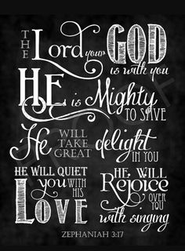
Remember who God says you are.
Treasured possession (Deut 7:6)
Chosen, holy (Col 3:12),
Beloved (Deut 33:2),
His child (1 Jn 3:1),
A friend (Jn 15:15),
Holy, blameless (Eph 1:4)
Redeemed (Eph 1:7)

Slide 33
Remember who Jesus is.
Jesus came into the world sacrificially. He was willing to empty himself, even to the point of death to display his love for us.
He does not hold his power and position over us but instead is devoted and sacrificing for us.
He does not rule over us, demand our affections, or subject to his majesty but woos us with his gentle and forgiving love.
Because of his love for us, Jesus was willing to be wounded and give up power.
And what he says he will do
  "He has sent me to proclaim liberty to the captives . . . to free those who are oppressed” (Luke 4:18-19)
  " I will rescue my flock; they shall no longer be a prey." (Ez 34:22).
  God encourages you to cry out to him for deliverance, "Rescue me, O Lord, from evil men; Preserve me from violent men" (Psalm 140:1).

Slide 34
Footnotes
1. Domestic Violence Statistics National Domestic Violence Hotline Website.
2. Center for Disease Control: The National Intimate Partner and Sexual Violence Survey - November 2011
3. US Department of Justice: The Bureau of Justice Statistics- August 1995
4. Bergen & Bukovec Men & Intimate Partner Rape, 2006
5. Maker AH, Kemmelmeier M, Peterson C. Long-term psychological consequences in women of witnessing parental physical conflict and experiencing abuse in childhood. Journal of Interpersonal Violence. 1998;13:574–589
6. Clark, R. Setting the Captives Free: A Christian Theology for Domestic Violence 2005.

