Slide 1
How to Help
Hearts Shaped By Trauma
Darby Strickland, CCEF

Slide 2
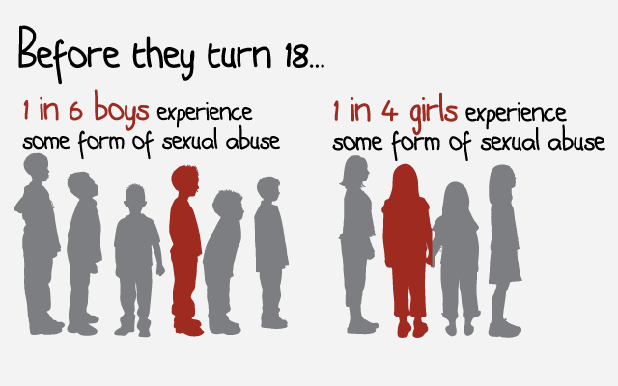
Childhood
Sex Abuse
About 60% of children who are sexually abused are abused by the people the family trusts¹
As many as 40% of children who are sexually abused are abused by older or more powerful children.
Abuse is about power and control. And sexual abuse is no different. It is always primarily about power and control.
  In fact, abusers groom their victims and communities in order to establish and enforce control

Slide 3
Why Children Do Not Disclose Abuse
‘Keep it a Secret’
Fear and Threats
‘I do not know who or how to tell’
Made to Feel Responsible-
Groomed
‘No one will believe you’
Dissociation
Punishment
Fear
Love
Why Don’t Parents
Report Abuse
Overwhelming feelings
Confusion
Physical, emotional, and financial dependency
Self doubts
Fears
Cost to family

Slide 4
Victims and
Future Victims
70% of child sexual offenders have between 1 and 9 victims,
20% have 10 to 40 victims. ¹
Confessing Abuse can be an act of grooming
  Who do they have sorrow for self or victim?
  Sex offenders groom in order to "define reality" for victims and their community so that they agree with the abuser's distorted thoughts, beliefs, and values. Their purpose is to control others' perspectives.
Abuse is about power and control. And sexual abuse is not different. It is always primarily about power and control.
  In fact, abusers groom their victims and communities in order to establish and enforce control
"The most chilling aspect of this behavior is its invisibility.“ Dr. Salter
1 Finkelhor, D., Ormrod,R., Chaffin, M. (2009) Juveniles who commit sex offenses against minors. Juvenile Justice Bulletin, OJJDP, Office of Justice Programs

Slide 5
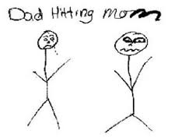
The Children and Domestic Violence
It is estimated that 80% to 90% of children living in homes where there is domestic violence are aware of the violence.
Unfortunately, children exposed to family violence are more likely to develop social, emotional, psychological and or behavioral problems.
Boys who witness domestic violence are 2x’s as likely to abuse their own partners and children when they become adults.
30% to 60% of perpetrators of intimate partner violence also abuse children in the household.
Mothers report that their children witness 20% of their sexual abuse
3.3 million children witness violence towards their mother every year

Slide 6
The littlest victims
What does
trauma do to a developing
Brain?
Body?
Soul?
Faith?

Slide 7
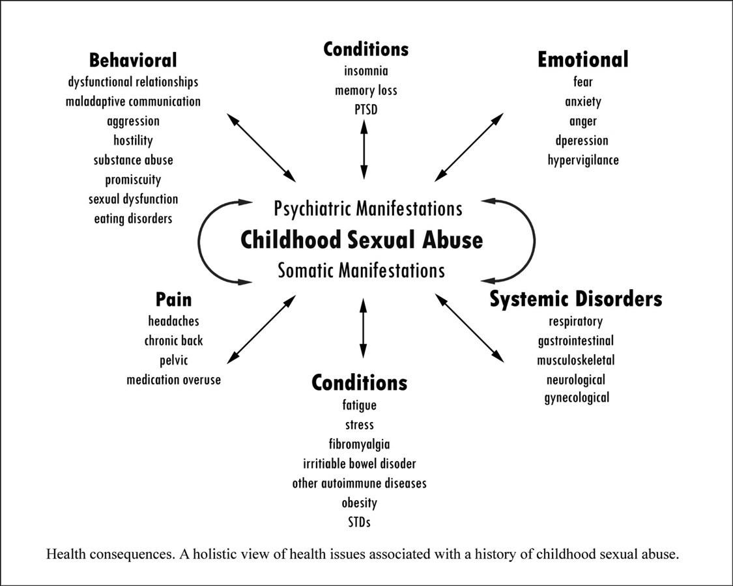
http://sol-reform.com/data/

Slide 8
Intimate partner violence is unpredictable and terrifying to both experience and reveal
The prudent sees danger and hides himself,
but the simple go on and suffer for it.
Pv. 22:3
We must see
We must respond
Seek to be God glorifying

Slide 9
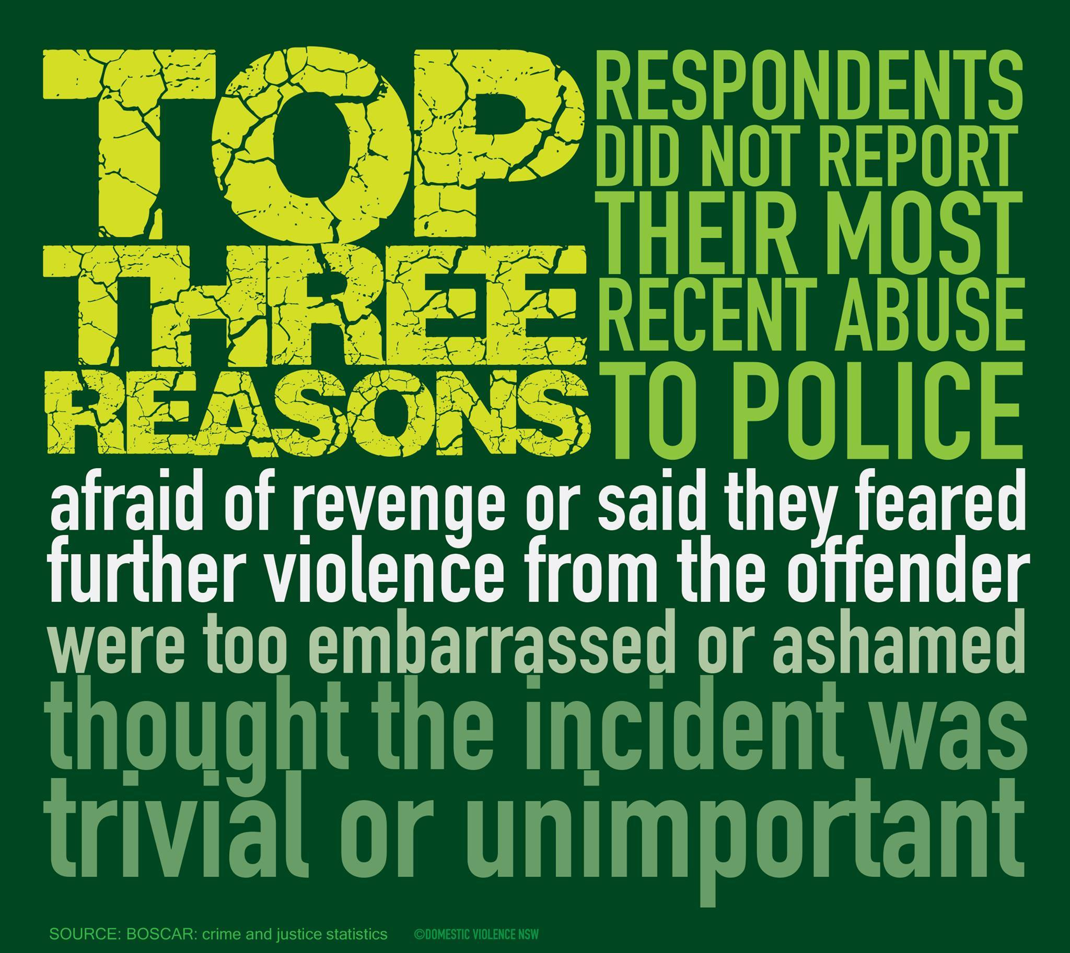

Slide 10
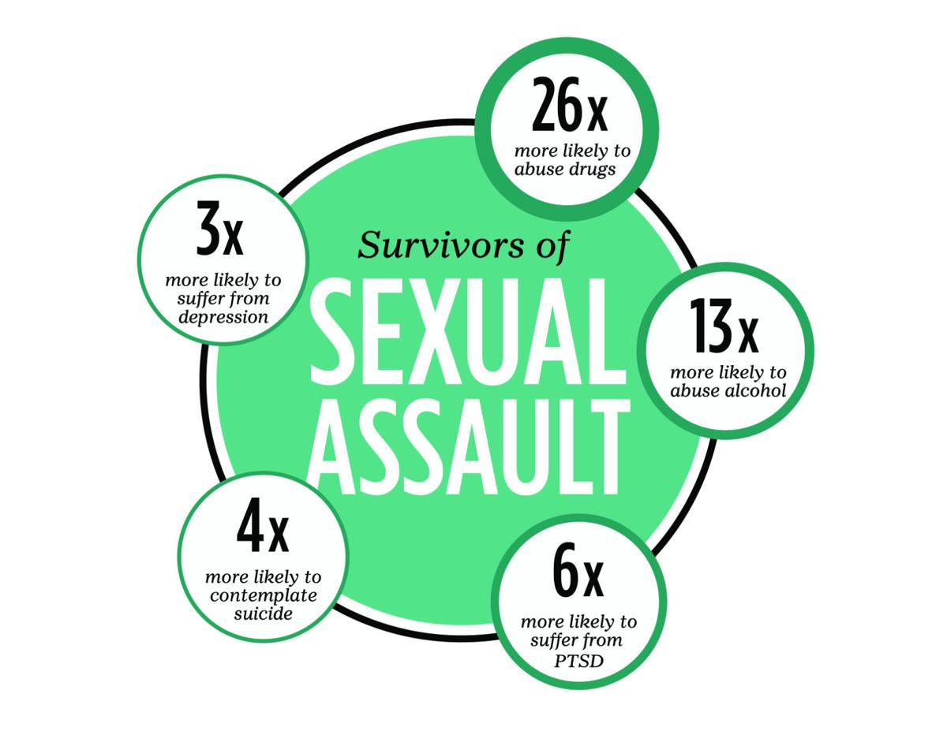

Slide 11
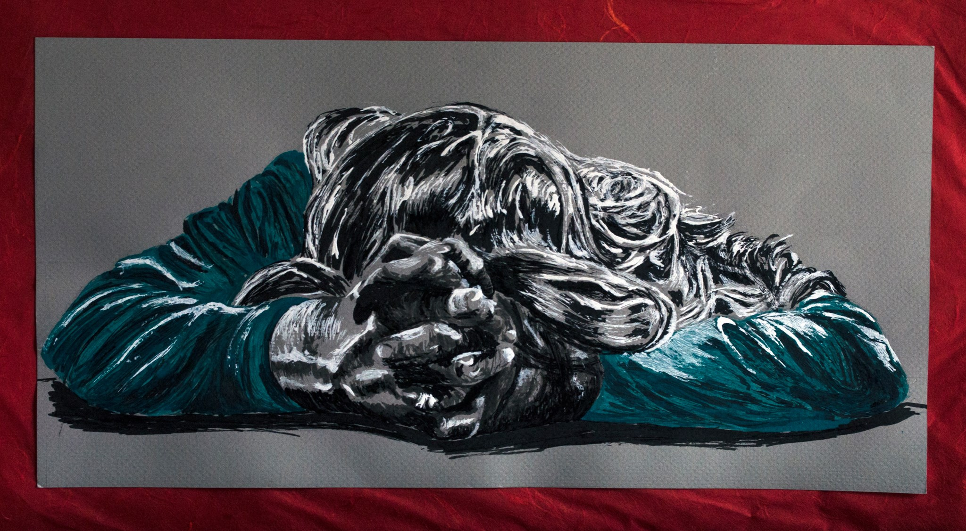
Katie:
What will people see?
Sharon Barshinger
What do we see?

Slide 12
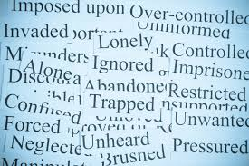
Who am I?
Abuse Distorts
Deserving of Abuse
Unworthy of Help
There is therefore now no condemnation for those who are in Christ Jesus. Rom 8:1
I will remember their sins and their lawless deeds no more. Heb 10:1
For we do not have a high priest who is unable to sympathize with our weaknesses, but one who in every respect has been tempted as we are, yet without sin. Let us with confidence draw near to the throne of grace , that we may receive mercy and find grace to help in time of need. Heb 4: 15-16

Slide 13

Who is God?
Abuse Distorts

Slide 14
Who are you?
Abuse Distorts
  Deep Fear of Trust
  Trust Easily Broken
  Asking- are you safe?
    Subconscious level-
    Perceptions
  Will you see/hear me?
    See my suffering or focus on my sin
    ALL of me?

Slide 15

What should I be doing?
Every Choice Leads to Pain & Loss
What would guide decisions?
Unsure of self, God and others
Confused about what is happening

Slide 16
Their Trauma Should
Changes Us for the worse overwhelmed-uninformed---> distancing judgmental
    Dangers for Our Hearts
And Tamar put ashes on her head and tore the long robe that she wore. And she laid her hand on her head and went away, crying aloud as she went. And her brother Absalom said to her, “Has Amnon your brother been with you? Now hold your peace, my sister. He is your brother;
do not take this to heart.
” So Tamar lived, a desolate woman, in her brother Absalom’s house
2 Sam 13:19-21
when he opened the doors of the house and went out to go on his way, behold, there was his concubine lying at the door of the house, with her hands on the threshold. ²⁸ He said to her,
“Get up, let us be going.” But there was no answer.
Then he put her on the donkey, and the man rose up and went away to his home Judges 19: 27-28

Slide 17
Their Trauma Should
Change Us
And all who saw it said, “Such a thing has never happened or been seen from the day that the people of Israel came up out of the land of Egypt until this day;
Direct your Heart to her, take counsel, and speak.”
Judges 19:30

Slide 18
Their Trauma Should
Changes Us
Weeping with those who weep-
Rejoice with those who rejoice,
weep with those who weep.
Rom 12:15
Worshiping God is to grow in rejoicing in what He rejoices in and to increase our weeping over what grieves him.

Slide 19
Our words shape suffering
Job Laments Job 3
Eliphaz rebukes Job 4
Job: Why did I not die at birth, come out from the womb and expire? v. 11
For the thing that I fear comes upon me,
and what I dread befalls me.
I am not at ease, nor am I quiet;
I have no rest, but trouble comes. v.25-26
Eliphaz: But now it has come to you, and you are impatient;
it touches you, and you are dismayed.
Is not your fear of God your confidence,
and the integrity of your ways your hope? v.5-6

Slide 20
Believed they were superior
(Job 5:8; 8:2; 11:2-12; 12:1-3)
Communicated judgment
(Job 4:4-9; 15:2-6)
Did not correctly portray the Lord
(Job 42:7)
Job’s friends
Our words shape suffering

Slide 21
Victim Blaming
Victim blaming occurs when the victim of a crime or any wrongful act is held entirely or partially responsible for the harm that befell them.
Why do we do this?
  To distance ourselves from an unpleasant occurrence and this gives a false sense that this could not happen to us.
  What we believe about sin and human nature. Being a sinner doesn’t mean that the victim sinned in a way that makes them directly responsible for the abuse.
  What we believe about suffering and the nature of God. If I am good I receive blessings- if bad then cursing.
  Don’t understand abuse- think it is like our normal relationships. Misunderstand we think that people have influence and are considered. Or even think it is safe to leave!
Victim-blaming reinforces what the abuser has been saying all along; that it is the victim’s fault that this is happening.
It is NOT the victim’s fault or responsibility to fix the situation; abuser’s responsibility
What are ways that we unknowingly blame victims?

Slide 22


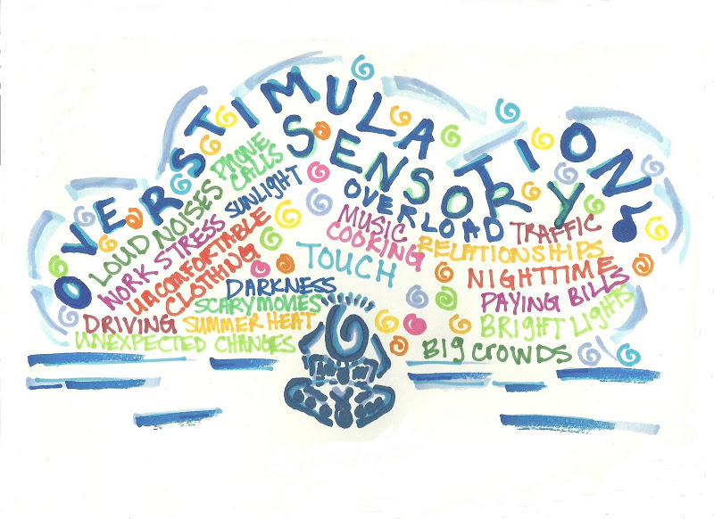
What
Is Wrong
with You?
“You are miserable comforters,
all of you!”
(Job 16:2).
Why do you stay with him?
It’s time to move on
Why aren’t you trusting God with this?
Are you sure?
Why didn’t you tell sooner?
Trauma
Trauma

Slide 23
Where are you sinning?
Move to our goals
before weeping
Focus on symptoms
over the story
Judge their strategies
Take over their agency
Unable to receive
correction
Unwilling to
hear and see
‘I will fix it’
vs.
We will sit in the brokenness together both depending on the Lord
Unchanged we will re-wound

Slide 24

Intrusions
What
do we
see?
Hypervigilance
Faith ?’s
Avoidance
Shame
Overwhelmed
Emotions
Physical
Anguish
Trauma

Slide 25
Intrusions
What
do we
see?
Hypervigilance
Faith ?’s
Avoidance
Shame
Overwhelmed
Emotions
Physical
Anguish
Trauma

Slide 26
Intrusions
What
do we
see?
Hypervigilance
Faith ?’s
Avoidance
Shame
Overwhelmed
Emotions
Physical
Anguish
Trauma

Slide 27
Intrusions
What
do we
see?
Hypervigilance
Faith ?’s
Avoidance
Shame
Overwhelmed
Emotions
Physical
Anguish
Trauma

Slide 28
Intrusions
What
do we
see?
Hypervigilance
Faith ?’s
Avoidance
Shame
Overwhelmed
Emotions
Physical
Anguish
Trauma

Slide 29
Intrusions
What
do we
see?
Hypervigilance
Faith ?’s
Avoidance
Shame
Overwhelmed
Emotions
Physical
Anguish
Trauma

Slide 30
Intrusions
What
do we
see?
Hypervigilance
Faith ?’s
Avoidance
Shame
Overwhelmed
Emotions
Physical
Anguish
Trauma

Slide 31
Look to Jesus to change
our hearts
&
questions
Intrusions
Hypervigilance
Be a student of their story
Faith ?’s
Avoidance
Shame
Overwhelmed
Emotions
Physical
Anguish

Slide 32
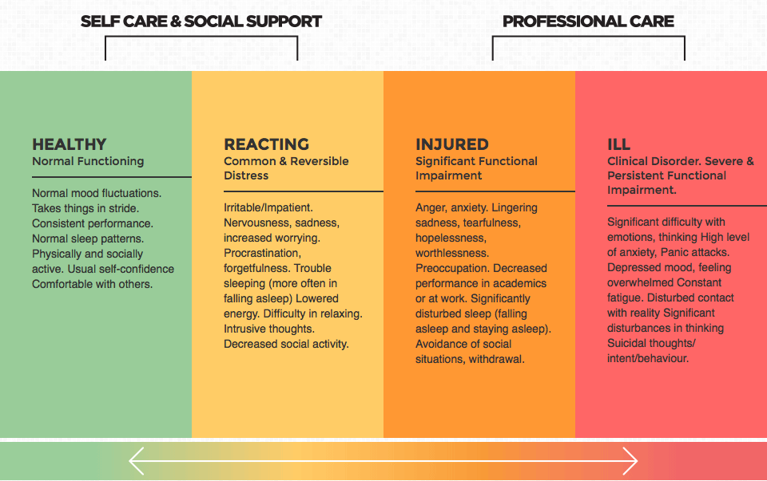
Community/Pastoral
When extra support is needed

Slide 33
Listen
Listen in a way that you are affected
I need to feel something of what they are feeling.
I need to suffer with them if they are suffering.
I need to enter into their confusion, fears, and frustrations.
Their story should change me
Their story should move me to enter in
This is the incarnational way that Jesus came to us
As I have loved you, love one another
Jn 13:34

Slide 34
Begin Speaking- to God and Others
Why? Speaking is key.
  Truth has been distorted
  Silence promotes abuse
  Learn to talk to God
  Cannot speak Scripture into the unknown
  Telling a story is powerful in the process of healing
  Eph 5 brings things into the light
  for redemption
  It is OK if this takes time
    Find a safe person
    Scary b/c talking makes it real
Trauma & Recovery- Herman
“The conflict between the will to deny horrible event and the will to proclaim them aloud in the central dialectic of psychological trauma. People who have survived atrocities often tell their stories in a highly emotional, contradictory, and fragmented manner which undermines their credibility and thereby serves the twin imperative of truth-telling and secrecy. When the truth is finally recognized, survivors can begin their recover. But far too often secrecy prevails and the story of the traumatic event surfaces not as a verbal narrative but as a symptom.”

Slide 35
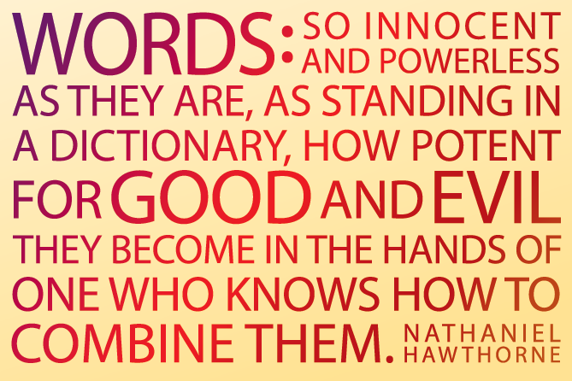

Slide 36
Words Shape the Narrative so
TELL IT
LIKE IT IS
The Bible remembers and names evil.
The Bible talks about traumatic things. Its stories are forged out of murder (Gn 4), infanticide (Ps 137), rape (Gn 34), dismemberment (Jgs 19; 1 Sam 18), kidnapping and forced marriages (Jgs 21), forced migration and slavery (Ex 21; Lv 25; Dt 15), genocide (Jos 1-12), political corruption (1-2 Kgs), oppression, and social desolation (the Prophets). A whole lot of sin and wounding happens within its pages.
God is blunt with his people when he talks to us about evil of all kinds, the devastating consequences of the fall, the misuse of power, and the ability of sin to wholly corrupt. it.

Slide 37
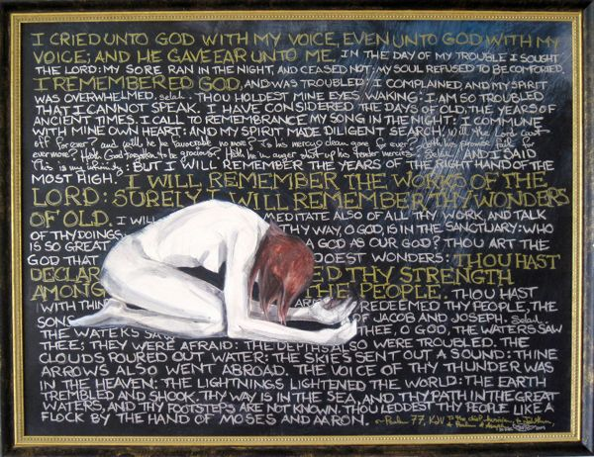
The Bible
Embraces
Expression
I cry aloud to God,
aloud to God, and he will hear me.
² In the day of my trouble I seek the Lord;
in the night my hand is stretched out without wearying;
my soul refuses to be comforted.
³ When I remember God, I moan;
when I meditate, my spirit faints. Selah
⁴ You hold my eyelids open;
I am so troubled that I cannot speak.
⁵ I consider the days of old,
the years long ago. (Ps 77)

Slide 38
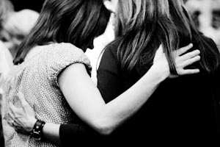
The words of the reckless pierce like swords.
But the tongue of the wise bring healing.
Proverbs 12:18

Slide 39
Jesus knows his sheep
Jesus is aquanited with t
trauma
    Jesus’ tenderness with broken people (us)
      He made himself little
      He came near
      His was wounded
        His heart
        His body
      He remembers
I am the good shepherd. I know my own and my own know me
Jn 10:14

Slide 40
He needs to change us
Blessed are the poor in spirit
Blessed are those who mourn
Blessed are the meek
Blessed are those who hunger and thirst for righteousness
Blessed are the merciful
Blessed are the pure in heart
Blessed are the peacemakers
Blessed are those who are persecuted for righteousness
Matt 5 - truncated
      Make yourself little
      Enter into darkness
      Listen in a way you are affected
      Be taught by their Trauma

