Slide 1
DOMESTIC ABUSE:
SETTING MINISTRY PRIORITIES
Darby Strickland, M. Div.

Slide 2
“The rule of thumb is that if someone is able to be verbally or physically abusive, he or she is able to understand that the behavior is wrong.”
― Edward T. Welch, Blame It on the Brain?: Distinguishing Chemical Imbalances, Brain Disorders, and Disobedience

Slide 3
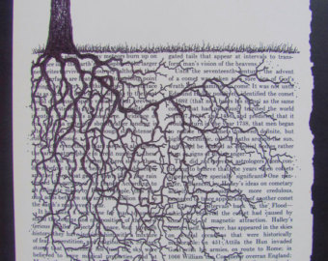
WE SHOULD ALWAYS BE SEEKING TO RESTORE WORSHIP
When we encounter the
Sufferer
Sinner
Saint
most of us are all three
(Mike Emlet)
We are looking towards redemption and restoring worship. Rooting a person in scriptural truths, a relationship with Jesus, encouraging them to trust and image God.
The presence of abuse adds the need to think about safety

Slide 4
CHANGE IS SLOW AND GOD IS PATIENT
“Sanctification is like a clumsy, slow walk rather than a light switch that we turn from off to on.”
-Edward T. Welch, When People Are Big and God Is Small: Overcoming Peer Pressure, Codependency, and the Fear of Man
God’s ministry to us involves accommodation. He adapts his help to individuals and communities. Like a good and wise father, God meets us where we are rather than waiting for us to come to him when we are ready. How we think about caring for others must always take into consideration how God cares for us. God’s relationship with us is our example and prototype. -Todd Stryd How Do You Know if Someone is Ready for Change JBC 34:2

Slide 5

IDEAL COMPONENTS IN SHEPHERDING
OPPRESSIVE MARRIAGES
Listen, believe (then verify) and carefully gather information– (Keep notes and logs)
Go over safety concerns and plan
Determine if confrontation is safe and/or desired
Develop a ministry plan to support the oppressed
Ask, connect, pray, schedule follow-up, build support team, consider practical relief,
Be slow to speak. Learn what she has tried & what it’s like
Develop a ministry plan to confront the oppressor if SAFE AND DESIRED
Do not always need to label their behavior as oppressive/abusive initially
Get to specifics quickly and in a detailed way
Assign elder to follow up, check-in and close the information loop
Key component - they know you will be checking in (with spouse).
Focus on repentance, humility, empathy and service.
Willingness to consider church discipline.
Revisit safety concerns and plan once confrontations are taking place.
Communicate with the oppressed prior to and post-confrontation- Fill them in!

Slide 6
VICTIM CARE
Again I looked and saw all the oppression
that was taking place under the sun:
I saw the tears of the oppressed
—and they have no comforter;
power was on the side of their oppressors—
and they have no comforter.
And I declared that the dead, who had already died,
are happier than the living, who are still alive.
But better than both is the one who has never been born,
who has not seen the evil that is done under the sun. Ecc 4

Slide 7
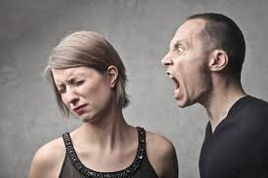
Serving our King vs. Being Enslaved to a King
REMEMBER THEM THAT ARE IN BONDS, AS BOUND WITH THEM; AND THEM WHICH SUFFER ADVERSITY, AS BEING YOURSELVES ALSO IN THE BODY.
HEBREWS 13:3
Ex 7:16 “Let my people go, that they may serve me”
Exodus & the deliverance from oppression/enslavement is not just deliverance from political/economic/social oppression or personal sin but it is about
our Lord reclaiming worshipers.

Slide 8

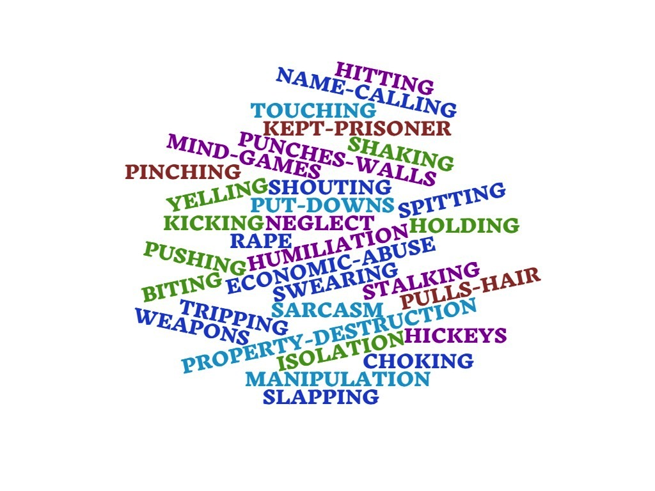
Punishing & Controlling Behaviors
Enforced Worship
Punishments are not always physical-
They are used to
rule over others
Entitlement & Self-worship
“Serve me or suffer the consequences.”

Slide 9
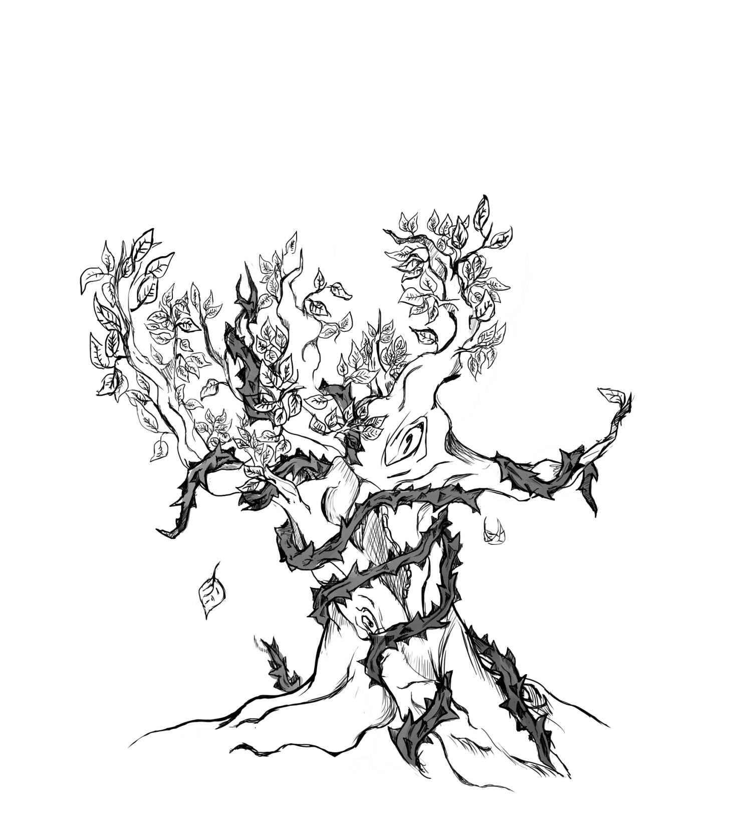


What is visible Reality
Typical marriage dynamics
Marriage of power & control
This is the reality. One spouse literally ensnaring and strangling the other.
We need wisdom, patience, and endurance to discern and discover the real reality.
Her anger, complaining, frustration, depression, lack of belief, not trusting God, demanding attention.
His business with work, devotion to other things, appears calm and pleasant, makes sense that he hides from wife she is so upset.

Slide 10
THE OPPRESSED ARE ENSLAVED
Fear of the Lord becomes replaced with fear of their spouse. One partner working hard to keep another from being angry and punishing.
Subject to harsh or cruel forms of perpetual domination.
Serve me or suffer physical, spiritual, or emotional pain.
Deliver me from the oppression of man:
so will I keep your precepts. Ps. 119:34

Slide 11
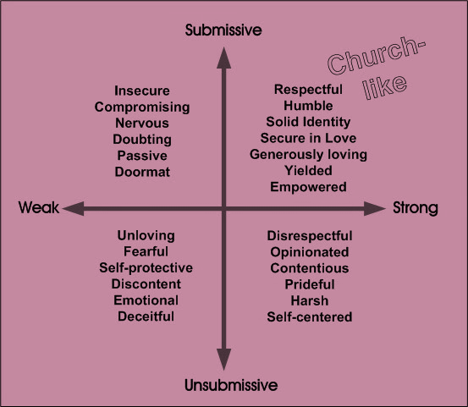
The
‘UNGODLY’
WOMEN

Slide 12

ABUSE DISTORTS- WE NEED TO FOCUS ON REDEMPTION
The oppressed need wisdom
to make many choices.
Do you even see options?
Most paths lead to pain
Obscures 2 important truths
Who and I?
God's chosen ones, holy and beloved
(Col 3:12)
What should I be doing?
Rest of Col 3 put off and on.
But when and how?

Slide 13
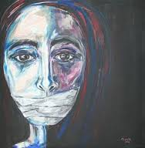
BEGIN SPEAKING- TO GOD AND OTHERS
Trauma & Recovery- Herman
“The conflict between the will to deny horrible events and the will to proclaim them aloud is the central dialectic of psychological trauma. People who have survived atrocities often tell their stories in a highly emotional, contradictory, and fragmented manner, which undermines their credibility and thereby serves the twin imperative of truth-telling and secrecy. When the truth is finally recognized, survivors can begin their recovery. But far too often secrecy prevails and the story of the traumatic event surfaces not as a verbal narrative but as a symptom.”
Why? Speaking is key.
  Truth has been distorted
  Silence promotes abuse
  Learn to talk to God
  Cannot speak Scripture into the unknown
  Telling the story is powerful in the process of healing
  Eph 5 bring things into the light for redemption
  It is OK if this takes time
    Find a safe person
    Scary because talking makes it real

Slide 14
DAMAGED OR RESPONSIBLE?
  Wounded not weaker.
  Enslaved not free.
Every move = injury
Literally ensnared
Dangerous and life starving.
No clear path
Victims hear:
  Co-dependent
  Low self-esteem
  “You are a pushover”- say no
  “I would have left him”
  “If you only said…. Did…”
  “Submit” better
  Responsible for your husband’s sanctification
  Good to suffer- so suffer better!
  Leads to victim blaming.

Slide 15
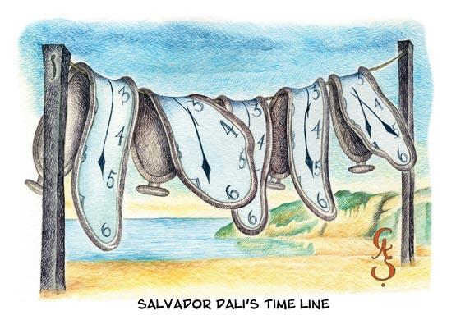
KEEP PACE
Might take a long time to be willing to let others know
You have much to lose
God is patient with us. You do not need people to tell you what to do. You are already married to someone who does.
Small steps build confidence and trust in the Lord.
Safety first

Slide 16
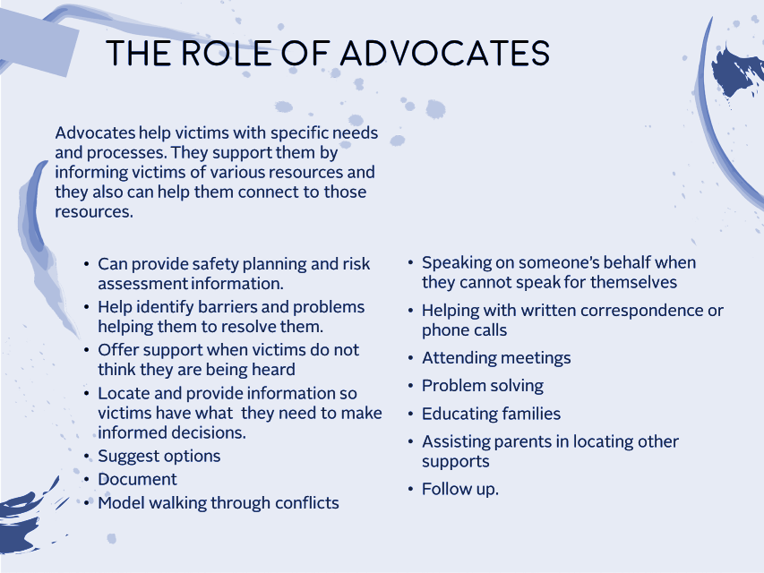
HOW TO HELP THEM START SPEAKING
Ask for a timeline
Use discovery questions
Show empathy and your own reaction to what you hear.
What do they fear or anticipate?
What have they tried & read?
How have they resisted the abuse?
Who have they told? How was it received?
Ask how/if they pray?
Do not shape it (yet)- Listen
Important to hear their words and experiences
Allow them to repeat
  background noise in their head.
Remember you cannot “solve” oppression-
Normalize their reactions.
Remember this is a
long journey

Slide 17
MINISTRY TO AN OPPRESSOR
LET HIM KNOW THAT WHOEVER BRINGS BACK A SINNER FROM HIS WANDERING WILL SAVE HIS SOUL FROM DEATH AND WILL COVER A MULTITUDE OF SINS. JAMES 5:20

Slide 18

WITH OPPRESSORS WE NEED MORE INFORMATION TO ASSESS IF THEY DESIRE TO CHANGE
We want to access a person’s openness to repentance; their current sin pattern is not just devastating them but those around them
In DA, we must work with an information base- not just what we encounter in counseling.
What is the victim is reporting
  the victim is the only one who sees what is happening behind closed doors
Knowledge of what we know about the typical patterns of oppressors
  what are the unique idolatries and behaviors of one who oppresses
Your interactions with the oppressor

Slide 19
Ensnaring distorted beliefs
I was created to be worshiped, not as a worshiper.
My words are the wisest and true words.
Everyone should worship me & work to bring me glory and honor.
My thoughts and opinions are infallible and perfect.
I do not require forgiveness.
I do not hurt others; they injure me.
My expectations are reasonable; others’ are not.
My care of others is impeccable.
All of creation exists for me to serve my needs and wants.
These are all true of our relationship with them!

Slide 20
THE ABUSER’S MAZE
Abusers work on you to feel sorry for them.
They work so that you see her as a cause of his torment.
Not about pain or feelings
Abused as child
Hurt by a previous relationship
Holds in his feelings
Afraid of intimacy
Addict
Hurt feelings
Low self esteem
All wrong assumptions

Slide 21

How they respond to us will be very telling… (& helpful)
Justified
Making rules/agenda for us
Twisting our words
Playing the victim
Charming
Creating allies (against us)
Ability to show empathy
Blame-shifting to you
Referencing other materials and experts
Compliant or slippery with words
Twisted sorrow
Rabbit trails

Slide 22


DO NOT FEED ENTITLEMENTS!
Enforcing their rules, feeding entitlements, blaming spouse.
Serving their agenda. Asking the oppressed to serve better.
Counsel one on one not as a couple.

Slide 23
THINGS THAT HELP
Concrete plan and exposure.
Do involve counselors or group counseling that are educated on abuse.
Patience- LONG TIME for insight to take place- 2+ years insight
Do involve other people in effort to both mirror back how others experience their behavior and to provide pressure to keep them involved in the change process.
Do work diligently as to minimize their punishing behaviors.
Do check in with their spouse. Only they can report how it is really going.

Slide 24
Ministering to the Oppressor
Help them give up power:
Willingness to be accountable, submit to authority
Acceptance of consequences.
Help them give up control:
Identify and repent of entitlements
Willingness to learn to suffer well
Willingness to consider others needs and desires
Commitment to safety
Identifying trigger points and develop a plan for them to avoid punishing reactions.
The freedom of spouse to say no without being bullied or badgered.
Learning to tolerate negative emotions without resorting to abusive acts.
Important not to negotiate safety.
Separation may be an important part of the safety plan.
Plan for and protect the unity of the leadership
and church body.

Slide 25
THE CHURCH IS UNIQUELY SUITED TO HELP OPPRESSORS
Oppression is really a deep-seated worship problem.
We are clear that we are not to live for our own desires but are called to serve and suffer.
Bible is rich in teaching humility.
Repent of control to a loving, sovereign God.
Offer a forgiveness that allows them to see the heinousness of sins and still stand.
Exposed yet loved by Jesus.
Discipline for restoration.
Exposure and pride will assist in motivating repentance- can’t pretend.
Jesus offers redemption.
But it is extremely difficult to give up entitlements and self-worship.

Slide 26
INTERACTIONS WITH OPPRESSORS
FOCUS ON DESCRIPTIONS OF THE ABUSER’S BEHAVIORS. “When you threw her to the couch” rather than “when you abused your wife,” or “you hit your girlfriend with a closed fist” rather than “you beat her”
  Tell it like it is
  Keep them as the subject of the sentence
FOCUS ON THE ABUSER’S BEHAVIOR RATHER THAN THE VICTIM’S. Abusers, often focus on the victim’s behavior rather than their own. They gloss over their actions and will go into long stories blaming victims or others for their problems.
  Watch empathy
  Highlight cause and effect of their behavior
USE A DIRECT AND CALM APPROACH. Care should be taken to approach the topic directly, matter-of-factly, and calmly. Showing your anger, disgust, or shock will derail the process.
What did you want to see happen?
What did you want to avoid?
How has your behavior benefited you?
What could you have done differently?
Chris Moles
Bills Due
2 hour lecture
-relationship
Despair
Prompting event
Controlling
Behavior
Consequence

Slide 27
QUESTIONS THAT BRING INSIGHT
What Happened?
We want to know the details of how they were abusive.
What did you want to accomplish?
What did they want to see happen or fear?
How does what you did communicae about your heart?
spouse, God and themselves
What was the outcome?
What was the impact on spouse and you?
What do you need to trust God with?
What new fruit would flow from this way of living?
How does God provide for you?
If you were trusting God, how would that shape your response?
QUESTIONS THAT MOTIVATE CHANGE

Slide 28
10 REASONS OPPRESSORS DO NOT TO CHANGE
-BANCROFT
1. The intrinsic satisfaction of power and control
2. Getting his way, especially when it matters to him most
3. Someone to take his problems out on
4. Free labor from her; leisure and freedom for him
5. Being the center of attention, with priority given to his needs
6. Financial control
7. Ensuring that his career, education or
other goals are prioritized
8. Public status of partner and/or father without the sacrifices
9. The approval of his friends and relatives
10. Double standards

Slide 29
Safety Victim
Church Discipline
Timeline shorter for counseling if not following recommendation or is unsafe
BIP
Safety Victim
Church Discipline if remains resistant
Help him see how his perception and behaviors are corrupted- offering him a better way to live
BIP
Safety Victim
Help him see how his perception and behaviors are corrupted- offering him a better way to live
Change is not word based- but needs to be seen in new patterns over extended time
BIP
HOSTILE
RELUCTANT
RESISTANT
OPEN
OP will exhibit abusive behavior towards you threats/bullying/manipulation/gaslighting
Passive reluctance or active resistance (ambivalence) to change- OP thinks you are wrong about him needing change
Appears open to change, at least at first. Shows a willingness to see and own their abuse

Slide 30
GODLY REGRET
Godly regret is good.
  Focused on how it offends God
  God’s Word as measure for how we see sin
  Brings restoration and redemption
The opposite of godly remorse is not always remorselessness-
  Feel sorry for how it is affecting themselves. Self-pity
  Pride will always regret making a fool of itself
  Detect that the people around us think it is stupid or silly or reprehensible
Godly regret produces repentance.
  So the test of godly regret is repentance. The test of whether our grief is of God or of the world is whether it produces change.
Godly regret leads to salvation.
Be willing to cause Godly Regret
Do not be fooled by Worldly Regret
^{2 Cor} 7 ¹⁰ For godly grief produces a repentance that leads to salvation without regret, whereas worldly grief produces death. ¹¹ For see what earnestness this godly grief has produced in you, but also what eagerness to clear yourselves, what indignation, what fear, what longing, what zeal, what punishment! At every point you have proved yourselves innocent in the matter. ¹² So although I wrote to you, it was not for the sake of the one who did the wrong, nor for the sake of the one who suffered the wrong, but in order that your earnestness for us might be revealed to you in the sight of God. ¹³ Therefore we are comforted.

Slide 31
REPENTING OF OPPRESSION
Admit fully to all past patterns
Admit behavior was wrong without blame-shifting
Understand it was a choice not lack of control
Recognize effects and show empathy
Identify in detail past entitled and controlling attitudes
Develop respectful behaviors
Replace his distorted view of spouse
Make amends
Accept consequences
Commit to not repeating
Give up past privileges
Understand lifelong process
Willing to be accountable for past and present
Only Person who know if this is happening is the spouse
Notes:
unde

Slide 32
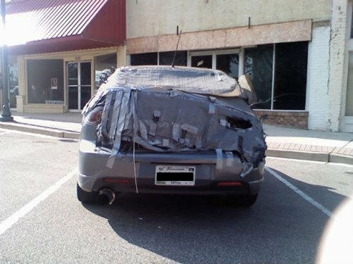
What is Most Glorifying to God?
  Pursuing sin
  Comforting the afflicted
  Exposing darkness
  Protecting the weak
  Truth telling
  Or keeping the institution of marriage together? (short or long term)
The sins of abuse are not ones Scripture calls us to overlook- but in fact they are called out as worse
in motivation and effect
– WC Q:151

Slide 33

CHILDREN ARE AWARE OF THE ABUSE
They see
They hear
They sense
They are frightened but often pretend not to be
They believe it is their fault
They want to talk
In families with children where abuse occurs
90% of children are in the same or next room during an incident.

Slide 34
Biblical Truths Victims Need

Slide 35

OPPRESSION VIOLATES GOD'S DESIGN FOR MARRIAGE.
God designed marriage to be a place of mutual trust, sacrifice, care, and honesty
Oppressors make it a place of domination.
  To get their needs met, they use manipulation & unrelenting pressures.
  Oppressors are willing to wound to preserve their position of power.
Your calling is not to submit to and accept rampant destructive behavior.
You are supposed to help your spouse know you,
serve, love, and be more like Jesus by limiting
their ability to sin against you, resisting their domination and exposing their sin.

Slide 36
IT IS NOT YOUR FAULT.
Abusive behaviors are inexcusable.
  Many appropriate ways to communicate displeasure
Nothing you could have done makes you deserving of abusive treatment—nothing ever.
"What comes out of a person is. . . from within (them), it is out of a person's heart that evil thoughts come—sexual immorality, theft, murder, adultery, greed, malice, deceit, lewdness, envy, slander, arrogance and folly. All these evils come from inside (them).” - Mark 7:20-23
Your oppressor will blame you for their anger and rage. But God clearly says it is never your fault.

Slide 37

SPEAKING TO GOD ABOUT HOW
THEY FEEL IS VITAL AND BIBLICAL
God invites you to lament
God understands the deep betrayal that comes from a close companion.
  "For it is not an enemy who taunts me—then I could bare it; it is not an adversary who deals insolently with me—then I could hide from him. But it is you, a man, my equal, my companion, my familiar friend. . . Let death steal over them; let them go down to Sheol alive; for evil is in their dwelling place and in their heart." (Ps 55:12-13,15).
God understands when we are angry, resentful & without hope. He knows our hearts and he knows the unique suffering and wounds of oppression.
  Ps 18, 22, 55, 56 & 57, are particularly relevant.

Slide 38

Truth to Teach: God cares about safety.
Sin intensifies over time.
Continual & unrepentant sin causes hearts to grow hard.
Desensitized hearts not only perpetuate sin,
they magnify it.
God’s word is clear on the dangers of unrepentant habitual sin.
We should not be unwisely optimistic
Abigail and Nabal
Egyptian Midwives
Jesus Fleeing-
    Matt 12:3-4 Pharisee's colluding to kill him, he withdraws
    John 8:58-59 They picked up stones to stone him and he hides- slips out
    John 11:53-54 They plotted to take his life so he no longer moved publicly and withdrew to the wilderness.
Paul- repeatedly fled abusive situations
  Acts 9:22-25; 14:5-7;17:8-10,14
Vindicate me, O God, and defend my cause against an ungodly people,
From the deceitful and unjust man deliver me!
For you are the God in whom I take refuge… Ps 43:1-2

Slide 39
GOD'S DESIRE IS TO RESCUE.
When God talks about oppression, he talks about rescuing his people,
  " I will rescue my flock; they shall no longer be a prey." (Ez 34:22).
  "I have surely seen the affliction of my people. . . and have heard their cry because of their taskmasters. I know their sufferings, and I have come down to deliver them (Ex 34:3).
  Jesus says he has "He has sent me to proclaim liberty to the captives . . ., to free those who are oppressed, (Luke 4:18-19).
  God encourages you to cry out to him for deliverance, "Rescue me, O Lord, from evil men; Preserve me from violent men" (Psalm 140:1).

Slide 40
IDEAL COMPONENTS IN SHEPHERDING
OPPRESSIVE MARRIAGES
Listen, believe (then verify) and carefully gather information– (Keep notes and logs)
Go over safety concerns and plan
Determine if confrontation is safe and/or desired
Develop a ministry plan to support the oppressed
Ask, connect, pray, schedule follow-up, build support team, consider practical relief,
Be slow to speak. Learn what she has tried & what it’s like
Develop a ministry plan to confront the oppressor if SAFE AND DESIRED
Do not always need to label their behavior as oppressive/abusive initially
Get to specifics quickly and in a detailed way
Assign elder to follow up, check-in and close the information loop
Key component - they know you will be checking in (with spouse).
Focus on repentance, humility, empathy and service.
Willingness to consider church discipline.
Revisit safety concerns and plan once confrontations are taking place.
Communicate with the oppressed prior to and post-confrontation- Fill them in!

